Slide 1
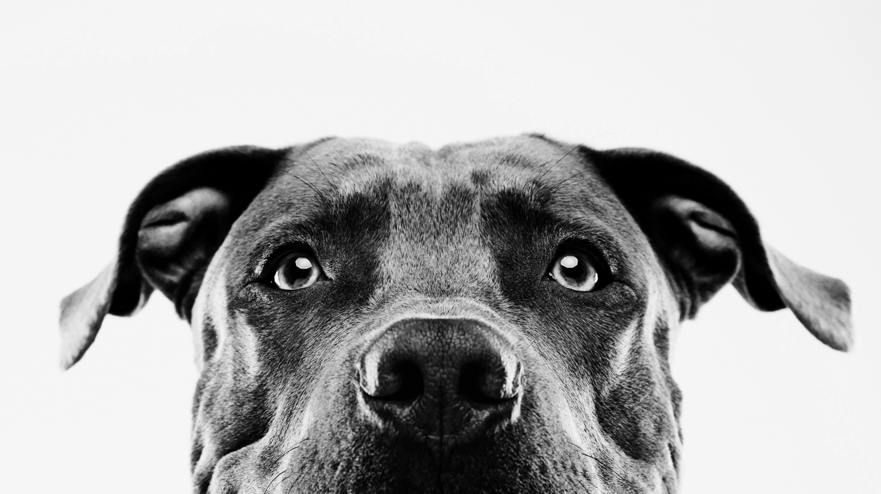
What kind of dog is it?
Deep learning final project

Slide 2
The idea
Identify the breed of a dog based on picture
Multi-classification problem
10,000+ pictures of 120 breeds

Slide 3
First attempts – Softmax and MLP
Just SoftMax
3 layers
[1 hidden layer]
5 layers
[3 hidden layers]

Slide 4
First conclusions
The results are not the best in terms of numbers
Takes a lot of time to run
The results are inconclusive.
The data needs more fine tuning.

Slide 5
CNN Model
In the final attempt, the model was built using CNN and TensorFlow 2.
The highest accuracy model was built with 5 starting layers of:
Convolution with increasing filter each time.
Batch normalization.
Max pooling.
Spatial dropout.
Then instead of using flatten, GlobalAveragePooling was used to collapse the given data from say [5 by 5 by 64] to [1 by 1 by 64].
Then it is connected to a Dense layer, then a dropout, and finally connected to the final layer, activated by softmax.
After iterating for around 2000 epochs the model reached a validation accuracy of around 17%.
WE also took the opportunity to use Data augmentation

Slide 6
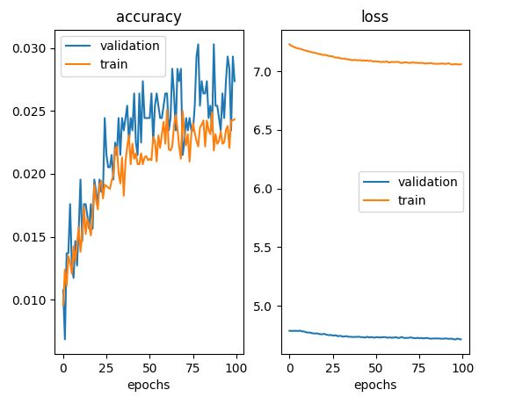
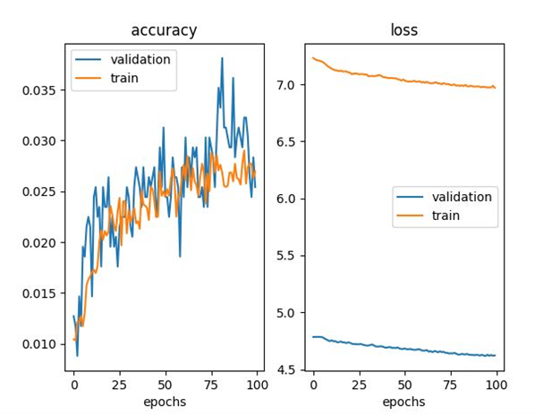


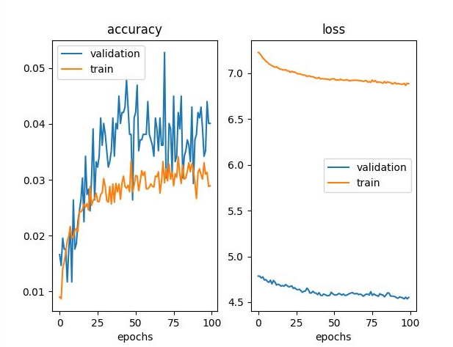
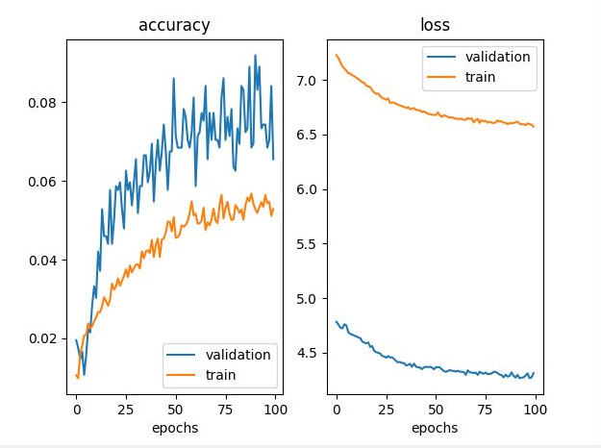


Experimentations
First we added layers upon layers until we got an overfitting model

Slide 7
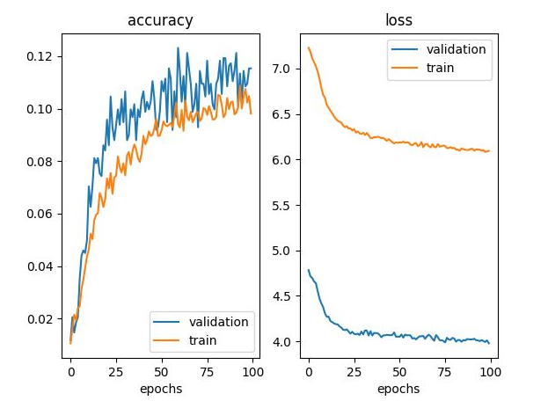
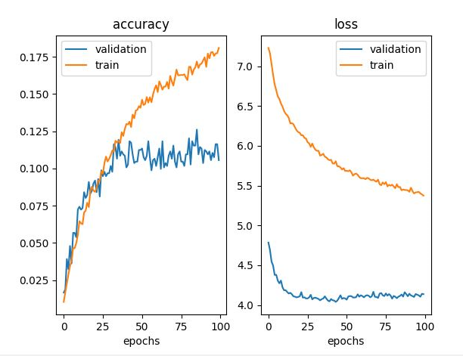



Then we backtrack to the last best
Since it’s starting to over fit

Slide 8
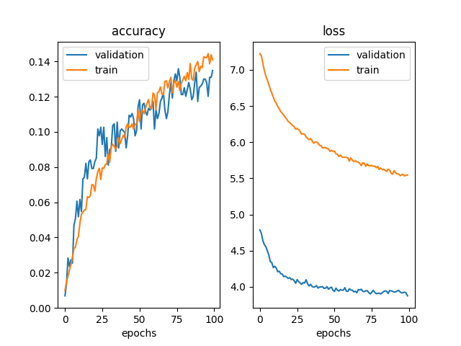
Dense layers
Using the 5-layer model, we add dense layer in variying Neurons
Best one was 1200 neurons

Slide 9
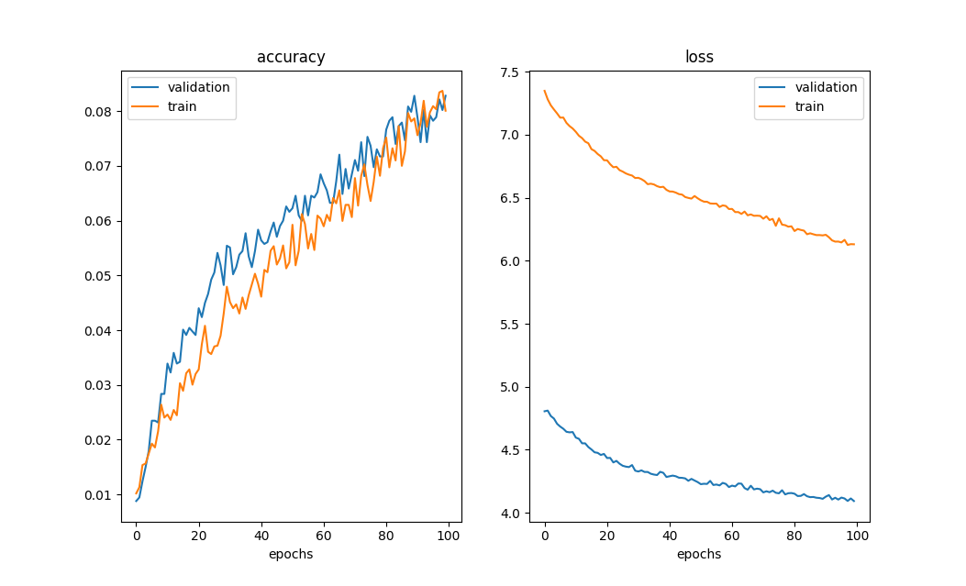
Batch normalization
Adding batch normalization between convolutions and dense.

Slide 10
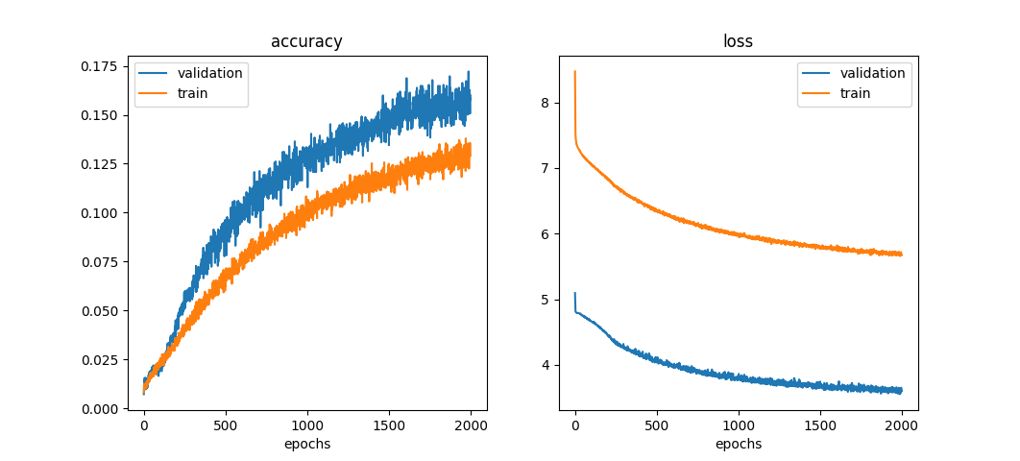
regularizeR
Adding regularizer L2 to the Dense layer.
This was achieved after 2000 epochs (overnight training)
This model cannot get a much better with more training
we conclude that this is the best it can get in a non-pretrained model Adding batch normalization between convolutions and dense.

Slide 11
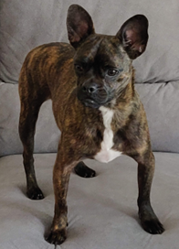
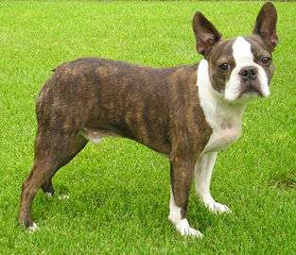
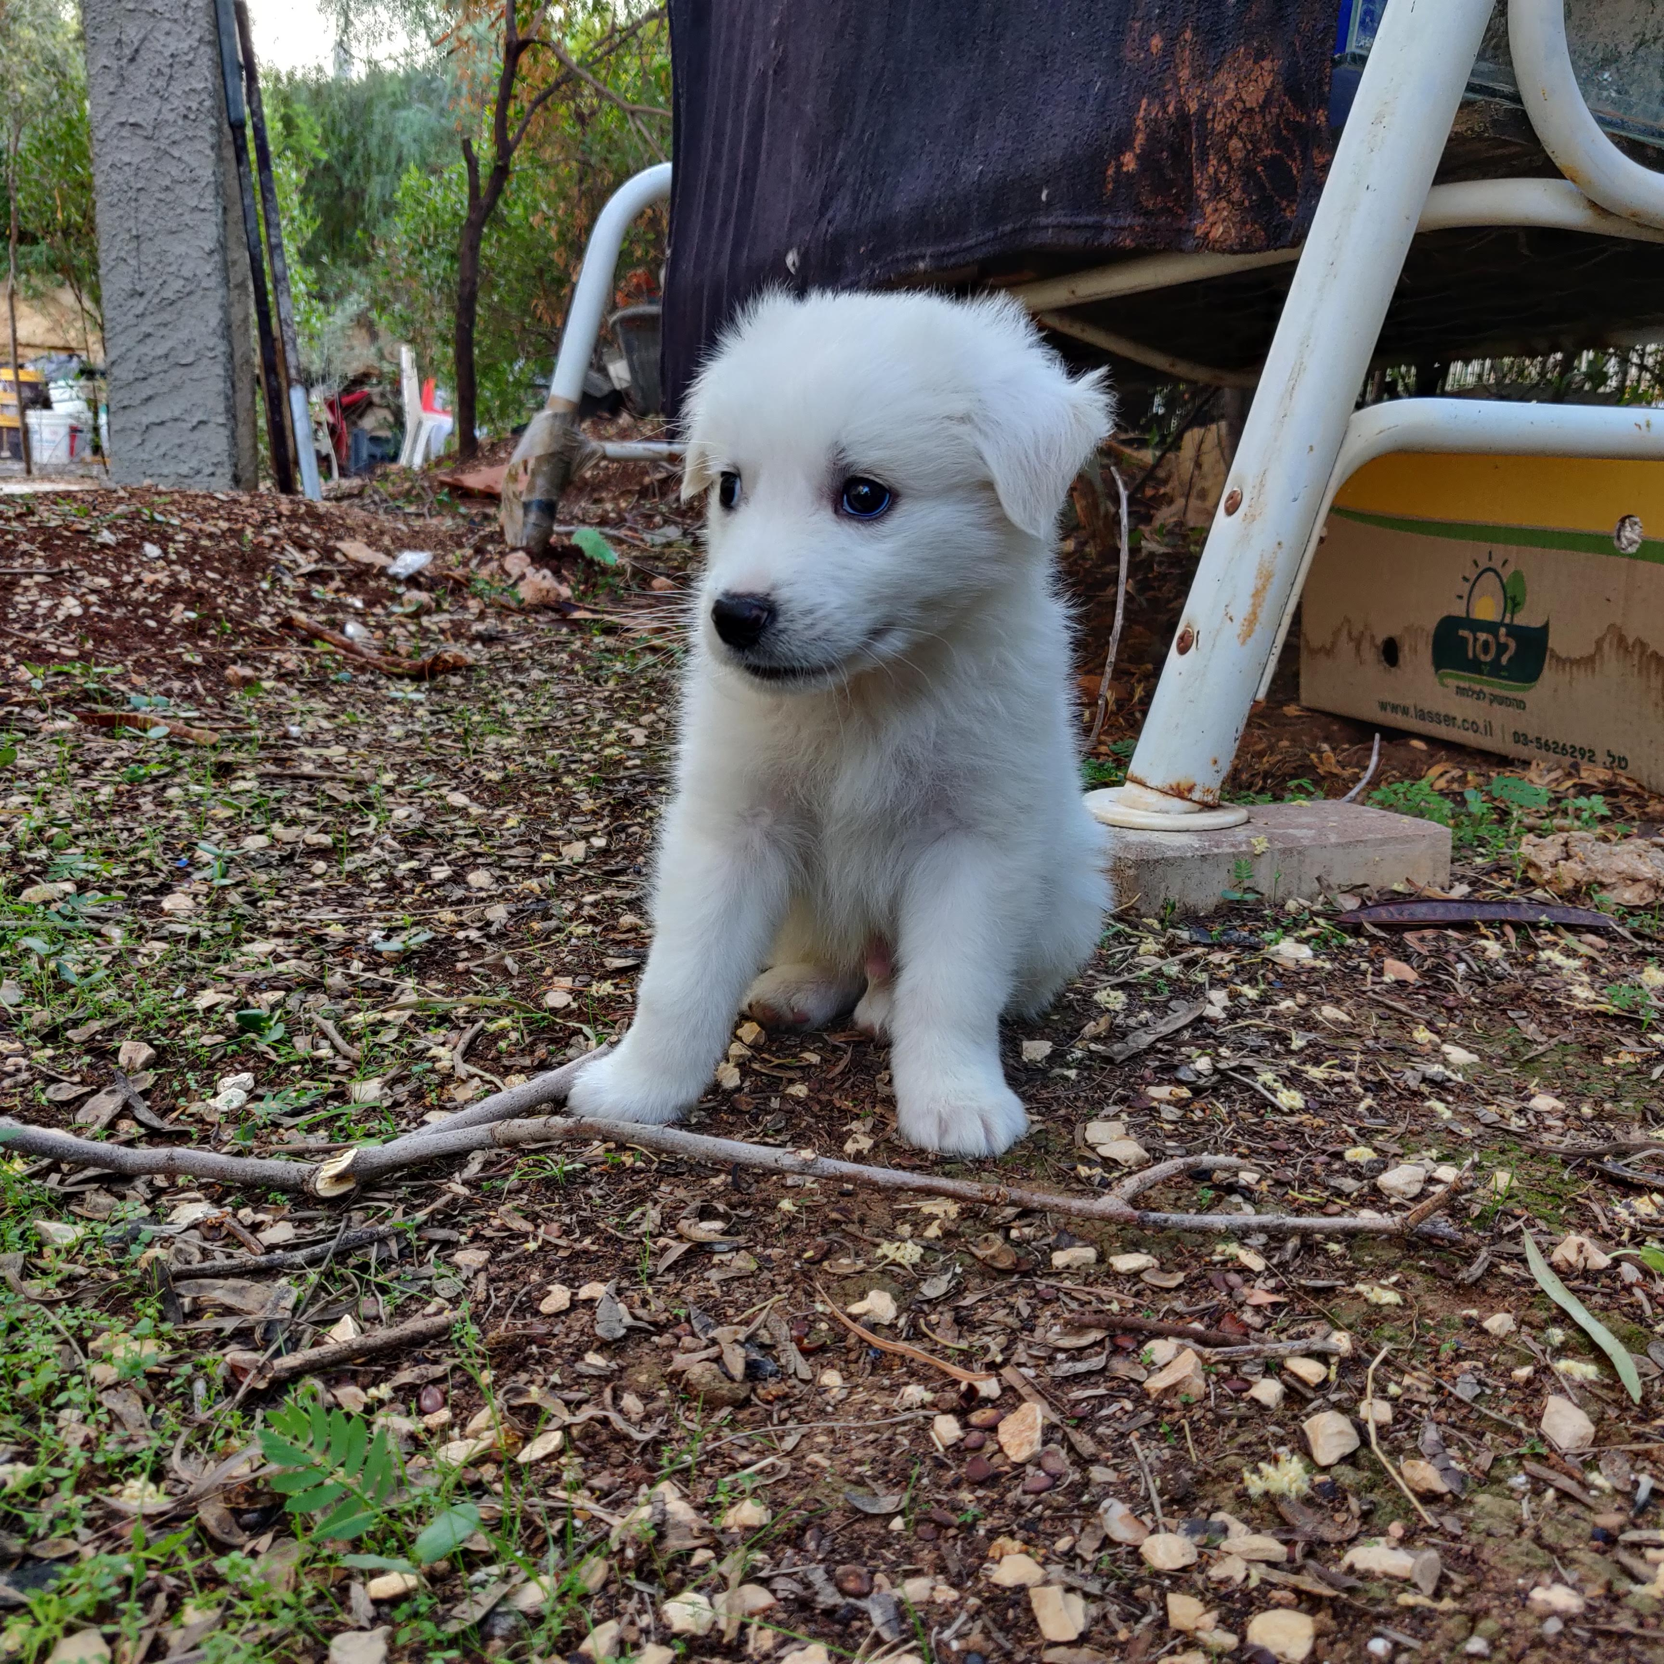
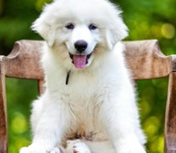
Results
A Boston bull mix
A Boston bull
We wanted to see if the model can guess random unknown images, despite the low accuracy
A Pyrenees Puppy
A Boston bull

Slide 12
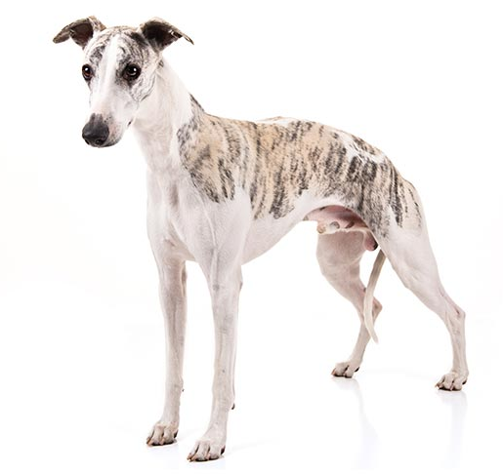
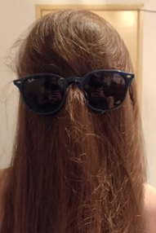
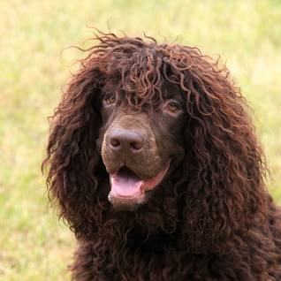
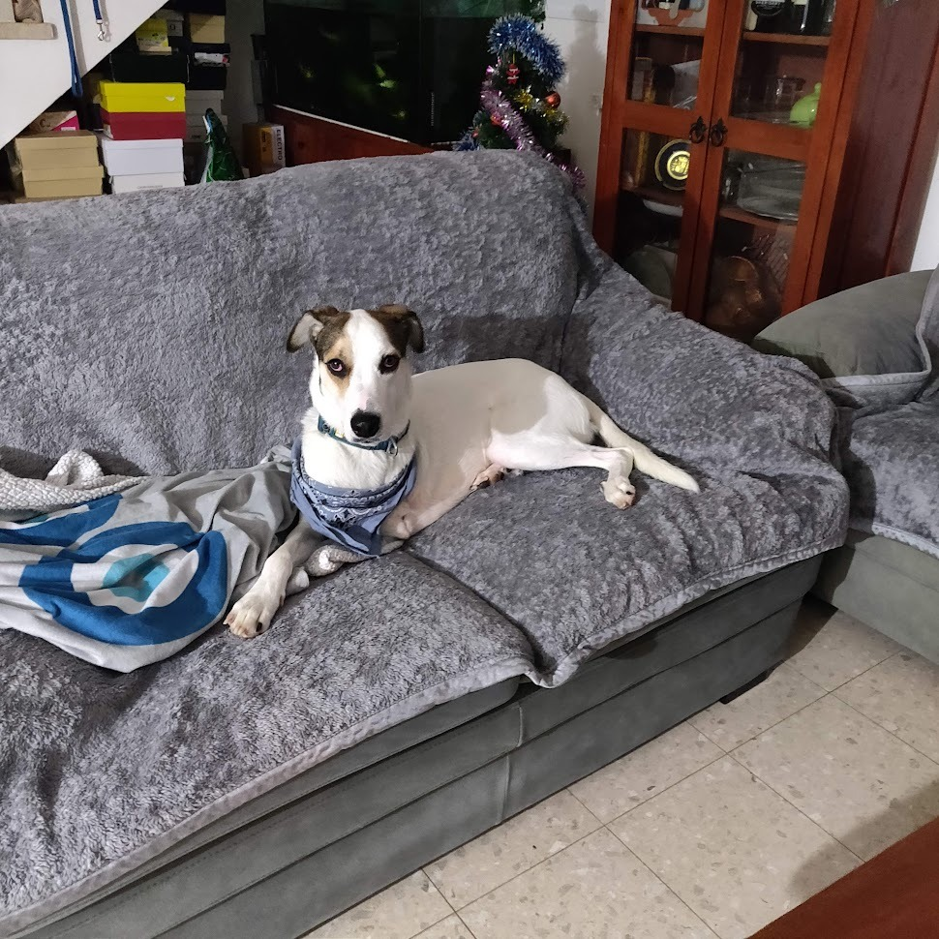
Close guesses (even with non-dogs)
Unknown mix breed
Whippet
My hair
Irish water Spaniel

